Slide 1
Complex phase resetting of bursting neurons in response to excitation implies slow outward current and spatial segregation of burst and SPIKE generating mechanisms
Selva Maran
Advisor: Dr. Carmen C. Canavier
08/24/09

Slide 2
Aim
To study phase resetting in a bursting neuron for excitatory inputs of different strength and duration
To explain the biophysical mechanism for the phase resetting using a model neuron

Slide 3
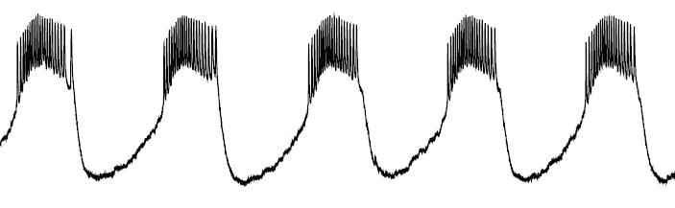
Bursting
Voltage trace from a regularly bursting neuron
One cycle
P₀
Notes:
One cycle
Just saying something that they already knew and sort of relevant here (to get their attention) (before – not sure what is relevant in this slide and now)
What is shown ….V trace ……..
Is a Firing pattern,
Burst -> Time interval during which …….interburst interval -> remains silence
Pattern repeats in time
Truncated …
One Spiking interval followed by the silence interval constitutes …… Cycle
When there is no disturbance the cycle length almost remains the same – P₀

Slide 4
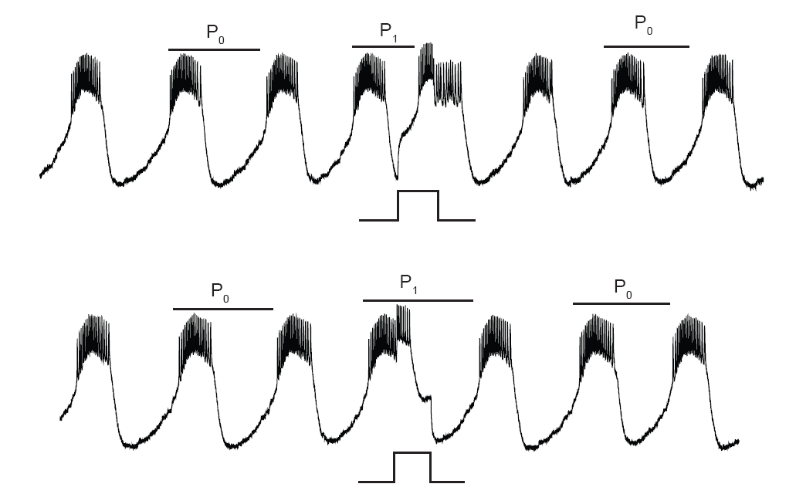
Transient perturbations affect cycle length
Notes:
Why this slide (Inputs affect length and location of input is imp.) (before and now)
Now when there ….
Which part of the cycle
For a given strength and duration ..the value ……….. Depending on where the input is given,For ex. In the beginning of the cycle or in the middle or towards the end
Phase resetting curve is a plot of the change in cycle length as a function of where the transient perturbation is applied. (excitatory inputs)
Voltage trace from bursting neuron

Slide 5
Materials and Methods

Slide 6
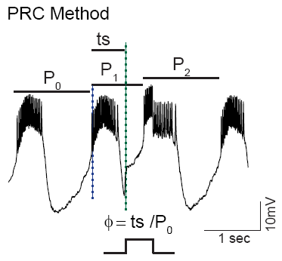
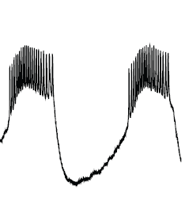
PRC method
ts ~P₀/2
ts ~P₀
Ф ~0
Ф ~1
Ф ~0.5
ts – Stimulus interval
φ -> Phase -> (ts/P₀)
Change in first cycle length -> (P₁ - P₀)
f₁(φ) = (P₁ - P₀)/P₀
f₁ - First Order Resetting
Change in second cycle length -> (P₂ - P₀)
f₂(φ) = (P₂ - P₀)/P₀
f₂ - Second Order Resetting
Notes:
Phase
We refer the time at which input is given within a cycle in terms of phase
Reference point - Blue line
Stimulus interval -Green line
Phase
0,0.5,1 (stressing more – something which people don’t get at first time)
So phase is just, normalizing the stimulus time at which input is given within a cycle
Phase reset
Second cycle after the input cycle
Second order resetting is not resetting due to input given in second cycle; it is actually the reset you see in second cycle due to an input in the previous cycle (stressing more – something which people don’t get at first time)
Phase resetting is also normalizing the change in cycle length

Slide 7
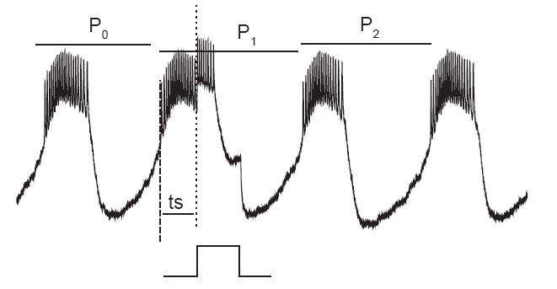
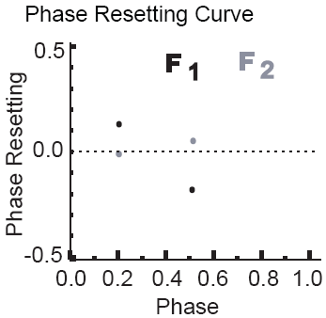
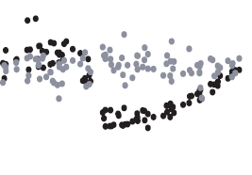
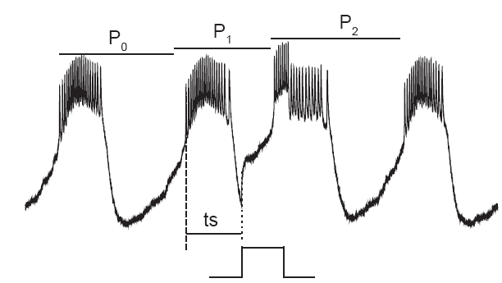
Phase Resetting Curve
P₁ > P₀; (P₁-P₀) is positive
F₁=(P₁-P₀)/P₀ is positive
Positive values -> delay (the onset of next cycle is delayed)
Negative values ->advance (the onset of next cycle is advanced)
P₁<P₀; (P₁-P₀) is negative
F₁=(P₁-P₀)/P₀ is negative
Notes:
Input of 20ns strength 500ms duration
Next step is just to show how we plot
If we repeat we have PRC
Positive and negative phase reset
In this plot x-axis and y-axis, An input is given around phase of 0.2 phase and corresponding phase reset values, the input at 0.2 would be mostly an input given during burst as shown in voltage trace here;

Slide 8
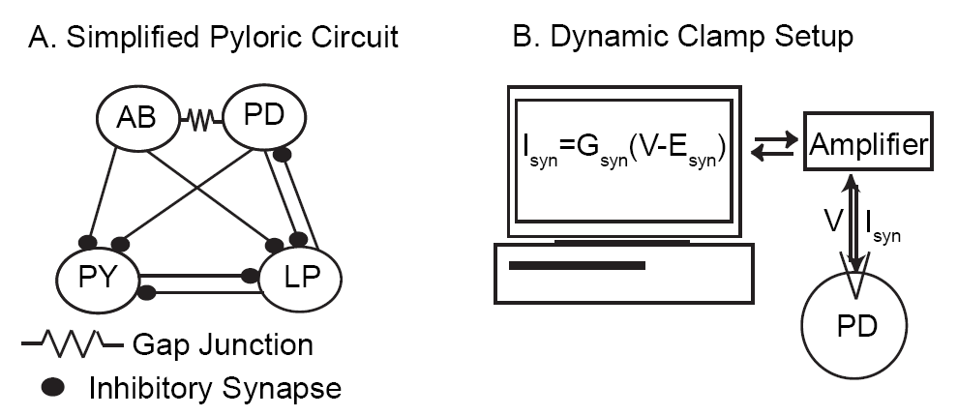


Experimental Setup
Experiments were done by Dr. Astrid Prinz Lab at Emory University, Atlanta
Notes:
How to put it?
Basically we were interested to study phase resetting in an intrinsically bursting neuron and the neuron that we chose is the
How to say the main points?
State the neurons?
Couple of important points here -
1) AB is main pacemaker neuron
2) Single unit
3) Why into PD
4) LP is blocked
5) Excitatory inputs
How the Artificial synaptic input is given?
No need to give more details …
using the dynamic clamp
Whenever the input has to be applied the Gsyn is changed from zero to desired set value and the V measure ………..

Slide 9
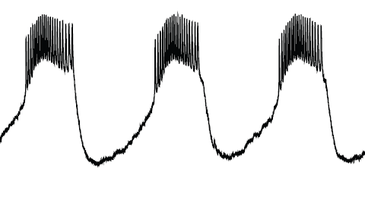
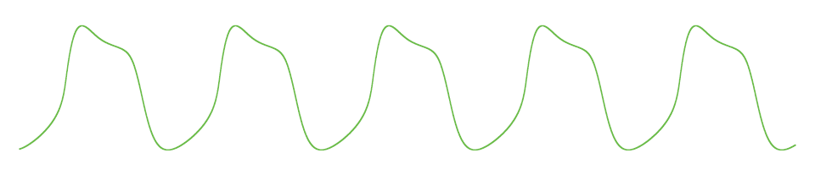
Bursting
Notes:
Bursting in a nutshell
There are two events
Slow oscillation
Spikes

Slide 10
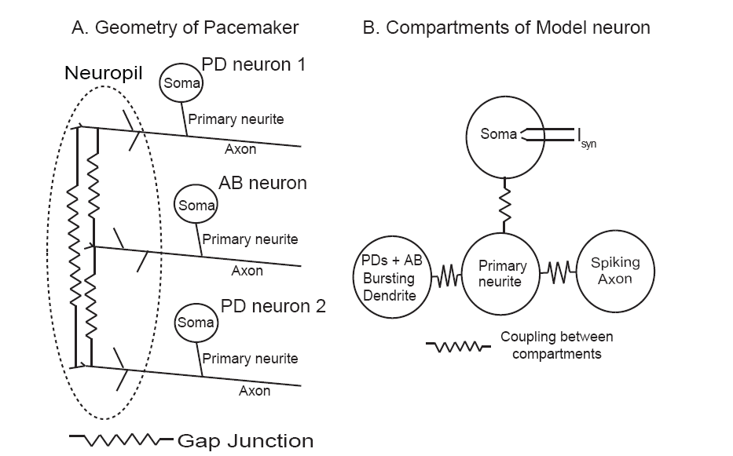
Model neuron
Major Currents:
Dendrites: I_{Ca} and I_{kca} Primary neurite: I_{Ks}
Axon: I_{Na} and I_{K,dr} Soma: I_{syn}
Notes:
Different from usual structure of neuron
Currents that are present in different channel
Major Currents:
Dendrites: I_{Ca} and I_{kca} Primary neurite: I_{Ks}
Axon: I_{Na} and I_{K,dr} Soma: I_{syn}

Slide 11
Results

Slide 12
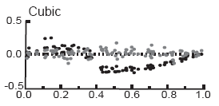
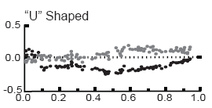
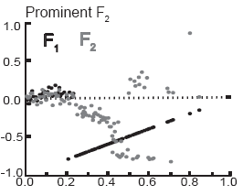
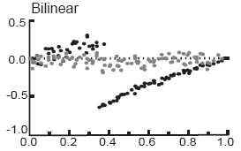
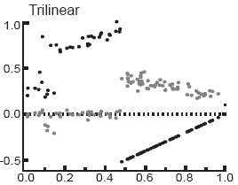
Five different PRC shapes
Short
<1/6th of P₀
Intermediate
1/6th – 1/3rd of P₀
Long
>1/3rd of P₀
Weak
Strong
P₀-> Intrinsic period or period of unperturbed cycle
Notes:
P₀-> Intrinsic period or period of unperturbed cycle
Short
<1/6th of P₀
1/6th – 1/3rd of P₀
>1/3rd of P₀
Long
Intermediate
Weak
Strong

Slide 13
Mechanism of slow oscillation
Notes:
Fast activation deactivation of calcium channels
Slow rise and fall in Ca conc.
Relaxation oscillator

Slide 14
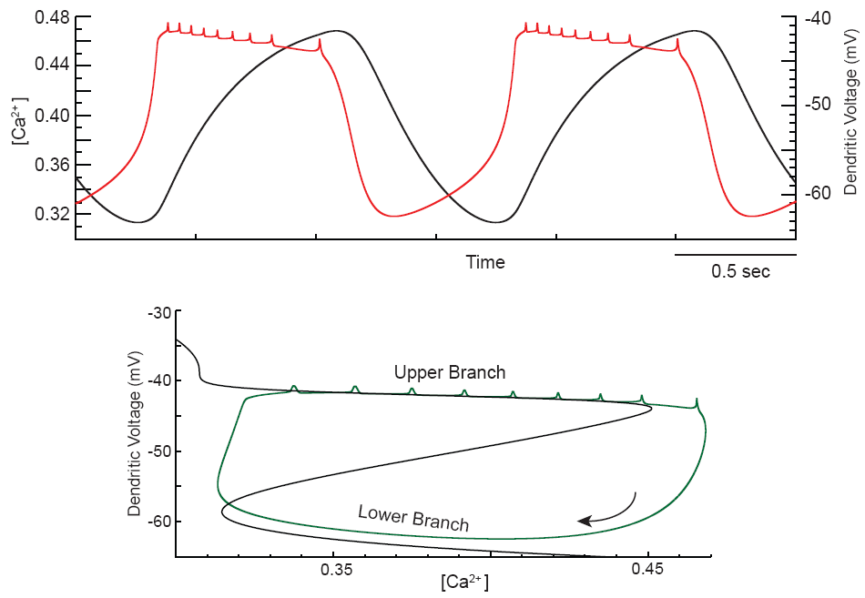
Phase plane Analysis
Dendritic voltage - fast variable
Calcium - slow variable
The black curve represents points where net membrane current is zero
Notes:
Black curve represents points where net membrane current is zero
Dendritic voltage - fast variable
Calcium - slow variable
Neuron goes to upper branch when Calcium channels gets activated
Neuron goes to lower branch when Calcium channels gets deactivated
Calcium channels gets activated fast on depolarization
Calcium channels gets deactivated fast on hyperpolarization
Slow dynamics for Calcium
Ca channels active
Ca channels deactive
Goes round and round this closed curve
Gets deviated when the input is given
Outward current is dominant below the black curve
Inward current is dominant above the black curve (conductance change – positive feedback)

Slide 15
Strong short inputs (Prominent F₂)

Slide 16
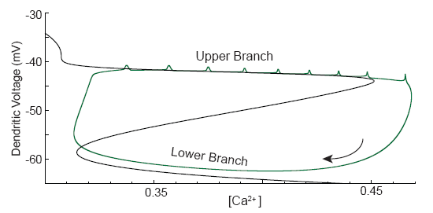
Branch switching hypothesis
Neuron goes to upper branch when Calcium channels gets activated
Neuron goes to lower branch when Calcium channels gets deactivated
Calcium channels activate (deactivate) fast on depolarization (hyperpolarization)
One of the major aim of our research was to verify branch switching hypothesis for short strong excitatory inputs

Slide 17
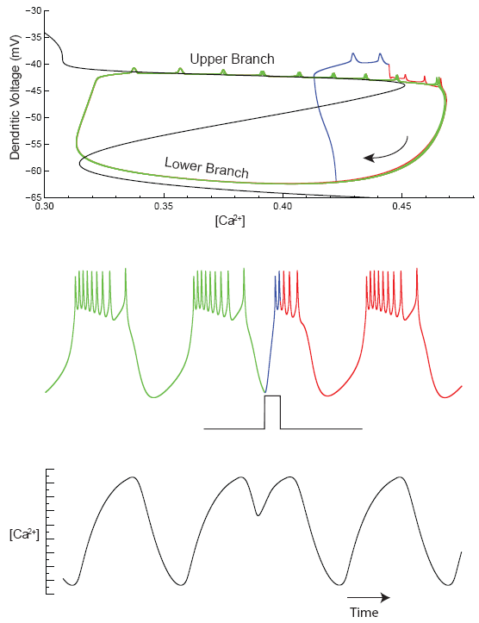
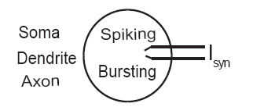
Branch Switching in Single Compartmental model
Green - Before input
Blue - During Input
Red - After Input
Notes:
The project is designed to verify one fact
Show slow dynamics for calcium
I_{Ca} active

Slide 18
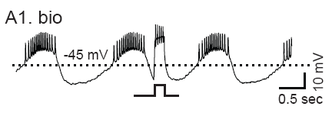
Absence of Branch Switching in biological neuron

Slide 19
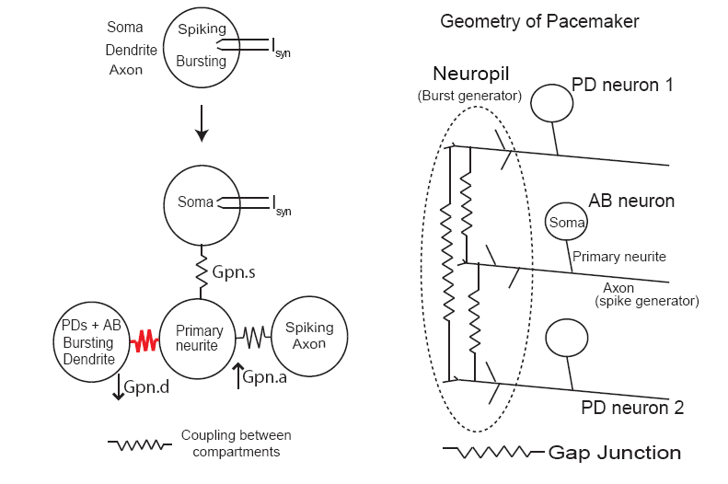
Multicompartmental Model

Slide 20
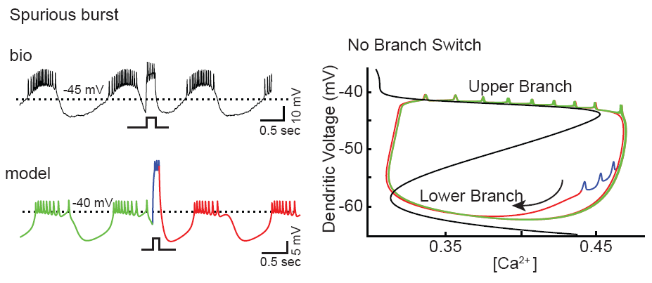
Absence of Branch Switching (Explained)
Notes:
Prominent F2

Slide 21
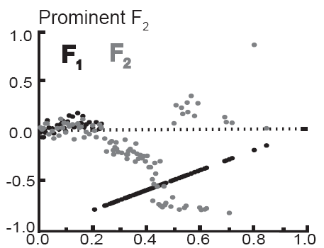
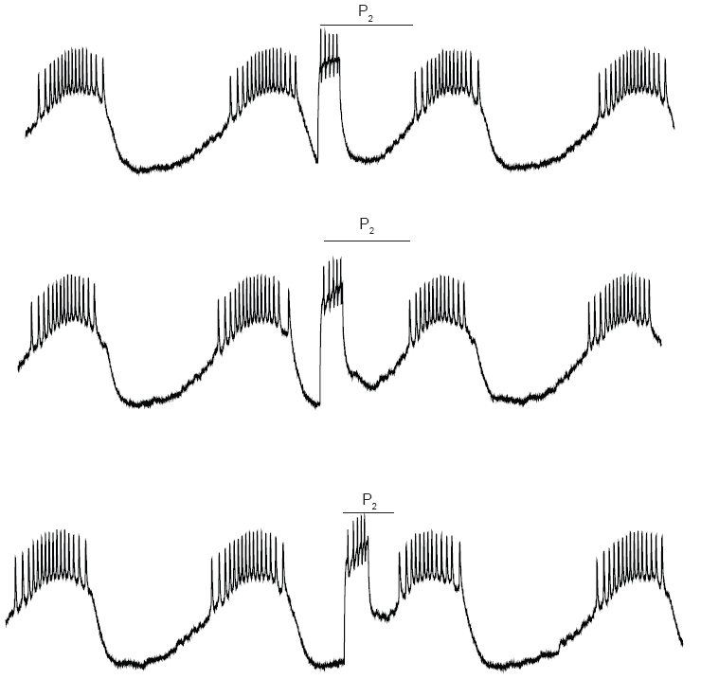
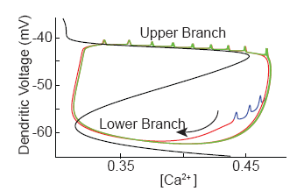
Why F₂ Prominent ?

Slide 22
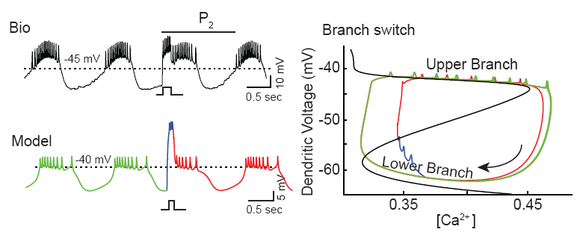
Late Inputs does cause branch switch
Green - Before input
Blue - During Input
Red - After Input
Notes:
Punch statement:
The neuron remains in the lower branch because the input is not affecting the dendritic comp. but it is able to spike because it is affecting the axonal compartment
How to put it? Obviously the second cycle length gets shorter and shorter …..
What is significant?
Understand why we got shape of PRC?
Why we had multicompartmental model?
What we expected here before getting the biological data?
What we observed?
How do we explain this?
Multicompartment is essential; Spatial segregation is important
Input is affecting the axon effectively and not dendrite
Why called as spurious burst?
Why prominent F2?
What happens towards end? Why branch switch was not obvious from voltage trace for late inputs?
If there is a branch switch then burst length should be reduced.
Conclusion:
Importance of spatial segregation

Slide 23
Summary Prominent F₂ (Strong short inputs)
Branch switching was not observed as expected for short strong excitatory inputs
Multicompartment model neuron was able to explain the absence of branch switching
Spatial segregation of burst generating and spike generating mechanisms is critical for absence of branch switching

Slide 24
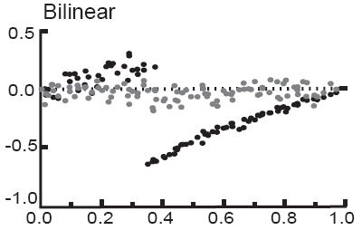
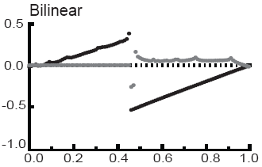

Bilinear PRC _{(Strong intermediate inputs)}

Slide 25
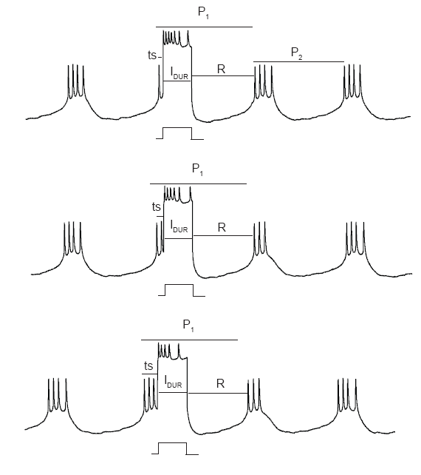
First segment of F₁
F₁(Ф) = Ф + constant value
R -> Recovery interval (time interval from end of the input to start of next cycle)
Notes:
For strong input neuron spikes throughout input duration
Recovery interval
F₁(Ф) = Ф + ((I_{dur} + R - P₀) / P₀ )
F(X)=a X +b

Slide 26
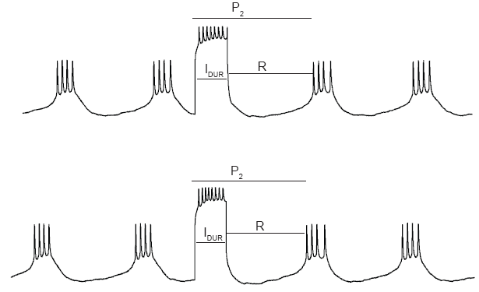
F₂ constant
Notes:
F2 constant

Slide 27
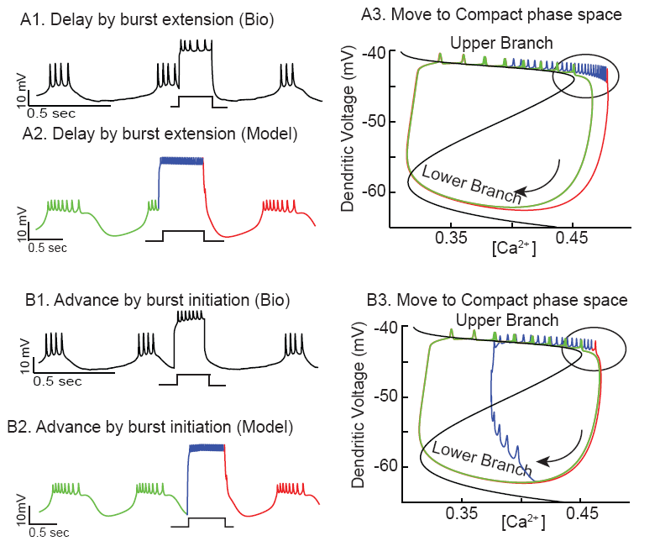
Why recovery interval is constant?
Input given during burst
Input given during
interburst
Neuron goes to compact phase space and stays in it
Green - Before input
Blue - During Input
Red - After Input
Notes:
Input given during burst
Input given during interburst

Slide 28
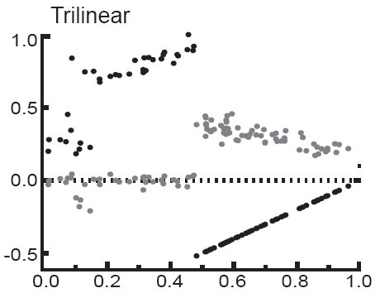
Trilinear PRC _{(Strong long inputs)}

Slide 29
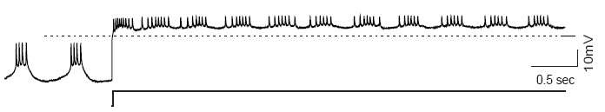
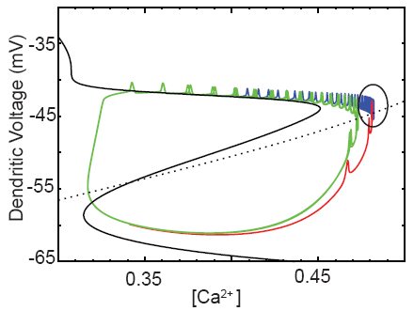
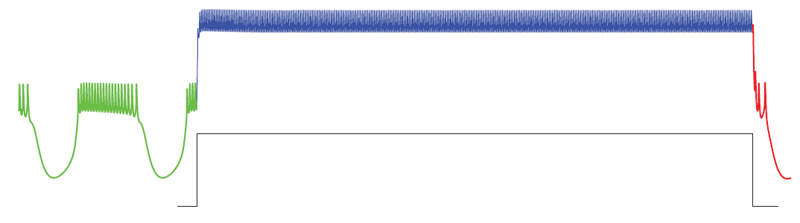
Burst is reestablished for Strong continuous excitatory Input in biological neuron
Biological neuron
Model neuron
Model neuron
Notes:
Biological neuron
Model neuron

Slide 30
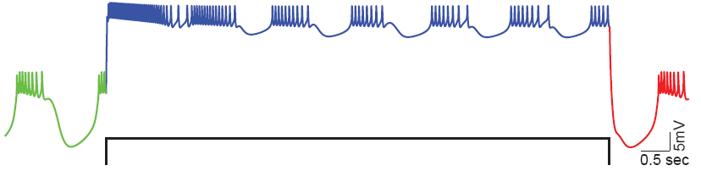
Very Slow Outward Current is required for reestablishing burst in model neuron
Very Slow Outward Current should be present in primary neurite or axon for reestablishing burst
Notes:
Very Slow Outward Current should be present in primary neurite or axon

Slide 31
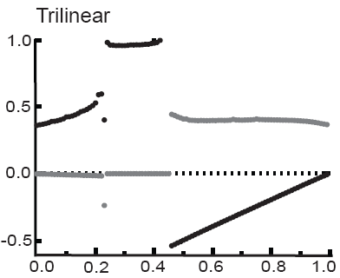
Model with Very Slow Outward Current reproduced Trilinear PRC
Notes:
To my surprise …………..
It was a bit of relief………
Unlike – this discontinuity is not artificial

Slide 32
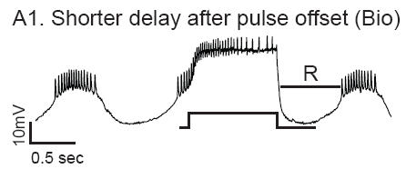
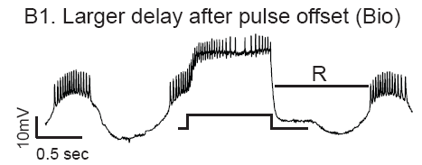
Smaller and larger recovery interval for early and late phase
Notes:
Unlike the other discontinuity – this discontinuity is not artificial, Nonlinear dynamics gives rise to discontinuity
Makes a loop
I speculated that it should be due to a very slowly activating outward current present either in primary neurite or axon, that gets activated when the strong input is given for a long duration.
Very slowly activating outward current gets activated
Pulls the neuron to lower branch but the neuron still spikes due to strong synaptic input
Now the KCa is deactivated because the Ca level is decreasing in soma
If the input ends before the black curve is crossed the neuron goes to lower branch and very slowly activating outward current gets deactivated
If the input ends after the black curve is crossed the neuron goes to upper branch and very slowly activating outward current remains activated in primary neurite and blocks the spiking
Once the neuron goes to lower branch the outward current in PN gets deactivated and the spiking begins in the next cycle. So basically it makes a loop before the next spiking start
Because of this loop the recovery interval is very long which gives rise to a longer delay.

Slide 33
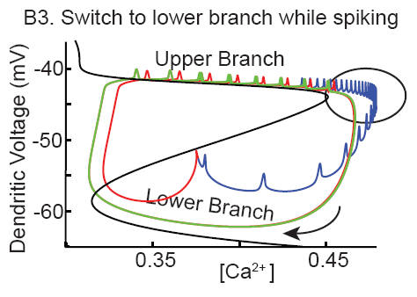
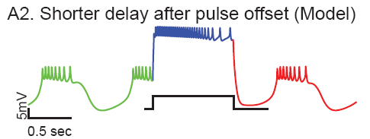
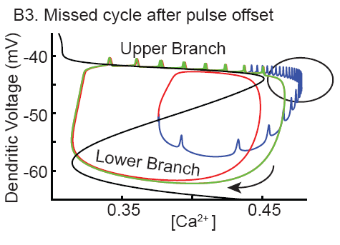
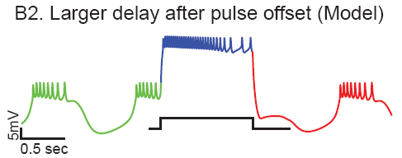
Trilinear PRC (Explained)
Activation of I_{Ks} for strong long inputs
Neuron Relaxes from compact space
Ca and I_{KCa} decreases
Input ends before crossing black curve
Neuron goes to lower branch
I_{ks} deactivates
Input ends after crossing black curve
Input goes to upper branch
I_{Ks} remains active and blocks spiking
Notes:
Activation of I_{Ks} for strong long inputs
Neuron Relaxes from compact space
Input terminates before branch switch
Neuron goes to lower branch
I_{ks} deactivates
Input terminates after branch switch
Input goes to upper branch
I_{Ks} remains active and blocks spiking

Slide 34
Summary (Bilinear and Trilinear PRC)
Bilinear PRC
Rebound or recovery interval (R) is constant
Model neuron shows that neuron moves into compact phase space and remains in it.
Trilinear PRC
Smaller and larger recover intervals(R)
Neuron relaxes from compact phase space even when the input is on.
Through the model work we predict that a very slow outward current is critical for relaxing from compact phase space
When the input ends after branch switch the slow outward current blocks spiking, even when the neuron is in upper branch

Slide 35
So Far ……
Short
<1/6th of P₀
Intermediate
1/6th – 1/3rd of P₀
Long
>1/3rd of P₀
Weak
Strong
Notes:
Short
<1/6th of P₀
1/6th – 1/3rd of P₀
>1/3rd of P₀
Long
Intermediate
Weak
Strong

Slide 36
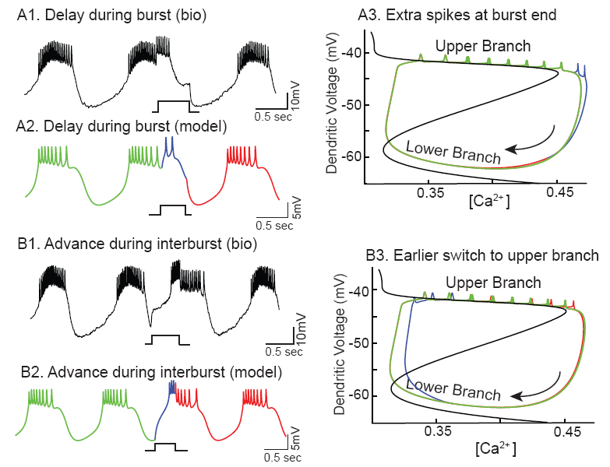
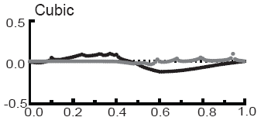
Cubic PRC (weak intermediate inputs)
Positive values -> delay (P₁>P₀)
Delay – the onset of next cycle is delayed
Negative values ->advance (P₁<P₀)
Advance -> the onset of next cycle is advanced
Green - Before input
Blue - During Input
Red - After Input

Slide 37
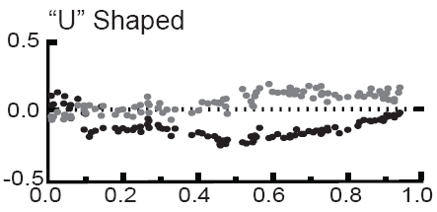
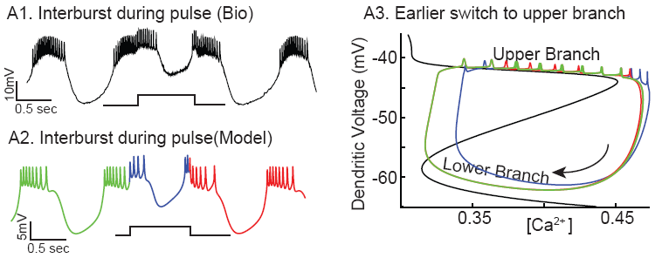
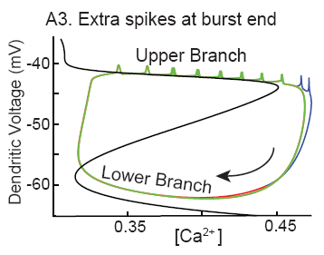

U shaped PRC (Weak long inputs)
Green - Before input
Blue - During Input
Red - After Input
Notes:
Why only advancement?
Compare with Cubic PRC -> for a weak input with intermediate duration u get a delay but here you are getting an advance
Why the delay is small compared to advancement? Or the advancement is greater than the delay?
-> Intrinsic mechanisms are more dominant than synaptic input whereas during the silent branch the intrinsic mechanisms are inactivated or deactivated or both and synaptic input is dominant
Why U shape?
Small delay becomes less prominent and if fully dominated by advancement similar to middle phases of cubic prc case.
Why F₂ prominent?

Slide 38
Summary (weak inputs)
Next burst can be advanced but not evoked immediately
Spiking is not elicited in the lower branch
For intermediate duration, there is delay and advances in resetting with smooth transition from delay to advance
For long duration there is mostly advances in the resetting

Slide 39

Strong short inputs
weak intermediate inputs
Summary
Strong intermediate inputs
Weak long inputs
Strong long inputs
Notes:
Summary

Slide 40
Conclusion
Five shapes of PRCs were observed in biological neuron
Our model neuron was able to reproduce all five PRC shapes and able to explain the biophysical mechanism behind all five shapes.
The phase plane analysis was more useful for understanding the phase resetting than just observation from voltage trace.
The absence of branch switching for short strong excitatory inputs is explained by the multicompartment model with spatial separation of spike and burst generation
We predict a previously unknown very slow outward current either in primary neurite or axon is essential to explain Trilinear PRC

Slide 41
Acknowledgement
Lab members
Dr Sairam Achuthan
Hani Nakhoul
Dr Lakshmi Chandrasekaran
Shuoguo Wang
Christopher Holdgraf
Dr. Astrid Prinz (Emory Uni.).
Fred Sieling, Kavita Demla, Ryan Hooper.
Dr. Carmen C. Canavier.

Slide 42
Thank you

Slide 43


Slide 44

Strong inputs evoke immediate onset of Burst
First Order phase resetting is (ф-1) at causal limit
f₁(φ) = (P₁ - P₀)/P₀
=(P₁ /P₀)- (P₀/P₀)
=(ts/P₀)- 1
=ф-1
Notes:
Tell them if phase is 0.7 then reset -0.3
If phase is 0.9 then the reset is -0.1
Phase advance is 1-ф
Phase resetting is –(1-ф)
(P₁ /P₀)- (P₀/P₀)
(ts/P₀)- 1
ф-1

Slide 45


Discontinuous F1
P₁
P₂
Interspike interval criteria
determines whether spikes due to input form part of the present cycle or next cycle
50 ms for Lobster recordings
75 ms for crab recordings
P₁
P₂
Notes:
Why there is a discontinuity in F1 at burst-interburst transition?
Two factors
methodology – criteria for defining burst
Strong input – evokes immediate spike.
Before 50ms -> the spikes for input are considered as extension of burst for present cycle and hence you get a huge delay. After 50ms -> the spikes due to the input are considered as part of new cycle or next cycle and hence the previous cycle is shortened.
Interspike interval criteria
determines whether spikes form part of old burst or new burst
50 ms for Lobster recordings
75 ms for crab recordings
P₁ P₂

Slide 46

Strong short inputs (Prominent F₂)

